Slide 1

Website Design & Creation
Workshop
March 1 and 2, 2014
Notes:
Hey everyone!
Today we’re going to talk about ChickTech. First of all, let’s talk about our name. CHICKtech. Yes, we’re using the word Chick in a positive context. Some people have voiced concerned over our name choice. We are reclaiming the word Chick, and we’re using it in a positive way. We are strong, powerful, confident, awesome CHICKS.
You can follow us on twitter, or check out our work-in-progress website chicktech.org. On there we have at least one mailing list that you can join.
<janice> I am the founder of ChickTech … <Janice’s short bio>
<jen> I’m a volunteer with ChickTech. I’m helping to organize workshops, reaching out to the Portland community for sponsorships and connections, and helping with the web presence. This is something I do in my spare time. As you may have heard on Wednesday, I’m also the community manager for Privly. And I’m a PhD graduate student in computer science at Oregon State University doing research around open source software. If you want to hear more about that, come to <this talk> later today.
Ok, now you know a bit about us. So let’s get going.

Slide 2

Welcome
Ready to create and design your own website? Start thinking about a topic!
Your Workshop Team
Katie
Holly
Caleb
Kurt
Tom

Slide 3
Introductions
What's your name?
What's your favorite website?
Notes:
So what are we actually DOING?
We’re in the process of organizing an event for the end of Janaury.
We’ll give 9 high schools, 10 tickets each to give to interested high school girls. 10 tickets will be reserved for alternatively educated high school girls.
The event will be 2 days, held at Portland State University. There will be about 7 hands on workshops – and we’ll go more detail into those later.
Then, somewhat unique to ChickTech, we plan to have a structure mentoring approach. Instead of having this be a one-off event, we want to ensure that the participants (who showed interest during the workshops) remain engaged. To do this, we’ll meet with the girls every other month to build on what they learned. We’ll do that for 1 year.
And our plan is to have very little “talking at” and more “doing”.
Next we’ll go into details about workshops. At the end we’ll talk about how you can help.

Slide 4
Reminders
5 min for pre-survey
10 min for post-survey
USB bracelets, electronic jewelry

Slide 5
Rooms
Website Design: EB 325
Notes:
Ok, here’s the list of each of the workshops. We’ll go through each of these a bit. If something sparks your interest or raises suggestions, write it down and we’ll discuss ideas at the end. If something is unclear, feel free to ask and we can try to help answer them.
Later, I’ll give you the status of each of the workshops. For now, we’ll just talk about what the workshops are.

Slide 6
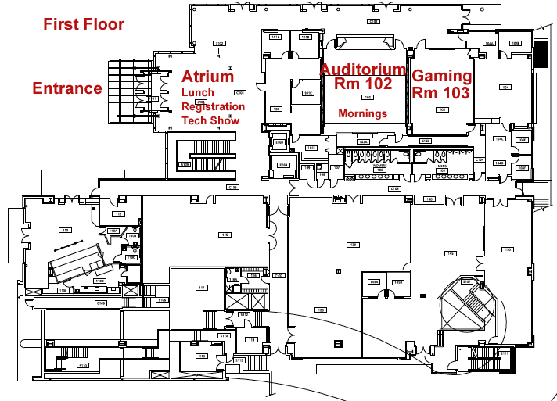

Slide 7
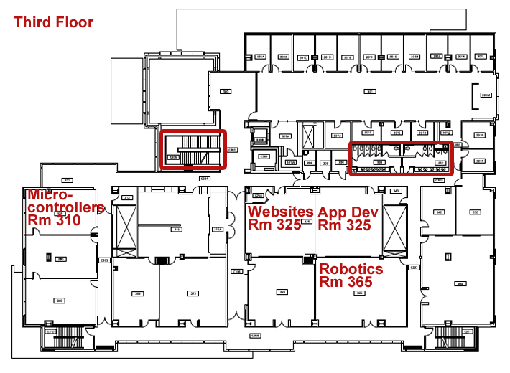

Slide 8
Tech Show
http://www.eventbrite.com/e/chicktech-high-school-tech-show-2014-tickets-10460881779
Open to the public! Even if you won't be at the rest of the event, try to come to the Tech Show to meet some of the girls!
Notes:
Ok, here’s the list of each of the workshops. We’ll go through each of these a bit. If something sparks your interest or raises suggestions, write it down and we’ll discuss ideas at the end. If something is unclear, feel free to ask and we can try to help answer them.
Later, I’ll give you the status of each of the workshops. For now, we’ll just talk about what the workshops are.

Slide 9
Why Mentoring?
Notes:
Ok, here’s the list of each of the workshops. We’ll go through each of these a bit. If something sparks your interest or raises suggestions, write it down and we’ll discuss ideas at the end. If something is unclear, feel free to ask and we can try to help answer them.
Later, I’ll give you the status of each of the workshops. For now, we’ll just talk about what the workshops are.

Slide 10
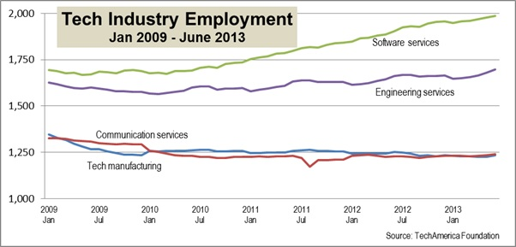
Opportunities
- Software is on the rise!
- … and we just can’t find enough good people out there to do all the work!
Notes:
So what are we actually DOING?
We’re in the process of organizing an event for the end of Janaury.
We’ll give 9 high schools, 10 tickets each to give to interested high school girls. 10 tickets will be reserved for alternatively educated high school girls.
The event will be 2 days, held at Portland State University. There will be about 7 hands on workshops – and we’ll go more detail into those later.
Then, somewhat unique to ChickTech, we plan to have a structure mentoring approach. Instead of having this be a one-off event, we want to ensure that the participants (who showed interest during the workshops) remain engaged. To do this, we’ll meet with the girls every other month to build on what they learned. We’ll do that for 1 year.
And our plan is to have very little “talking at” and more “doing”.
Next we’ll go into details about workshops. At the end we’ll talk about how you can help.

Slide 11
A Cornucopia of Careers
Software Developer
Web Developer
Project Manager
Systems Architect
Solutions Architect
Database Administrator
Development Strategist
Quality Assurance Engineer
Systems Administrator
Mobile App Developer
Web Designer
Front-End Developer
User Experience Designer
Graphics Artist
Content Administrator
Content Author
Photographer
Graphic Designer
Animator
Game Developer
Notes:
So what are we actually DOING?
We’re in the process of organizing an event for the end of Janaury.
We’ll give 9 high schools, 10 tickets each to give to interested high school girls. 10 tickets will be reserved for alternatively educated high school girls.
The event will be 2 days, held at Portland State University. There will be about 7 hands on workshops – and we’ll go more detail into those later.
Then, somewhat unique to ChickTech, we plan to have a structure mentoring approach. Instead of having this be a one-off event, we want to ensure that the participants (who showed interest during the workshops) remain engaged. To do this, we’ll meet with the girls every other month to build on what they learned. We’ll do that for 1 year.
And our plan is to have very little “talking at” and more “doing”.
Next we’ll go into details about workshops. At the end we’ll talk about how you can help.

Slide 12

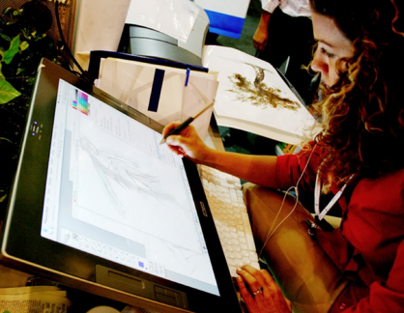
A (non-traditional) View of the Internet
A place where Developers and Artists come together to make things that radically alter our entire culture!
+
Notes:
So what are we actually DOING?
We’re in the process of organizing an event for the end of Janaury.
We’ll give 9 high schools, 10 tickets each to give to interested high school girls. 10 tickets will be reserved for alternatively educated high school girls.
The event will be 2 days, held at Portland State University. There will be about 7 hands on workshops – and we’ll go more detail into those later.
Then, somewhat unique to ChickTech, we plan to have a structure mentoring approach. Instead of having this be a one-off event, we want to ensure that the participants (who showed interest during the workshops) remain engaged. To do this, we’ll meet with the girls every other month to build on what they learned. We’ll do that for 1 year.
And our plan is to have very little “talking at” and more “doing”.
Next we’ll go into details about workshops. At the end we’ll talk about how you can help.

Slide 13
What the Internet is:
- A global system of interconnected networks.
- A “web” of systems communications.
- A whole lot of computers, in a whole lot of places, doing a whole lot of different things. (Facebook and Twitter are but the tip of the iceberg)
- A frontier.
Notes:
So what are we actually DOING?
We’re in the process of organizing an event for the end of Janaury.
We’ll give 9 high schools, 10 tickets each to give to interested high school girls. 10 tickets will be reserved for alternatively educated high school girls.
The event will be 2 days, held at Portland State University. There will be about 7 hands on workshops – and we’ll go more detail into those later.
Then, somewhat unique to ChickTech, we plan to have a structure mentoring approach. Instead of having this be a one-off event, we want to ensure that the participants (who showed interest during the workshops) remain engaged. To do this, we’ll meet with the girls every other month to build on what they learned. We’ll do that for 1 year.
And our plan is to have very little “talking at” and more “doing”.
Next we’ll go into details about workshops. At the end we’ll talk about how you can help.

Slide 14
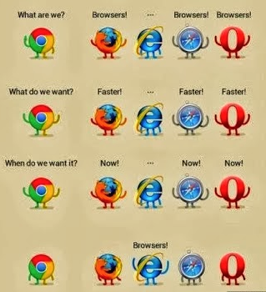
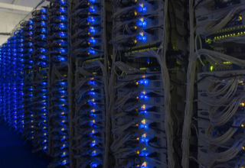
Web Technologies
Server Side (Back-End)
PHP
Ruby on Rails
Python / Django
.NET
Databases (MySQL, MongoDB, MS SQL)
Client Side (Front-End)
HTML
CSS
Javascript
Native Apps
Notes:
So what are we actually DOING?
We’re in the process of organizing an event for the end of Janaury.
We’ll give 9 high schools, 10 tickets each to give to interested high school girls. 10 tickets will be reserved for alternatively educated high school girls.
The event will be 2 days, held at Portland State University. There will be about 7 hands on workshops – and we’ll go more detail into those later.
Then, somewhat unique to ChickTech, we plan to have a structure mentoring approach. Instead of having this be a one-off event, we want to ensure that the participants (who showed interest during the workshops) remain engaged. To do this, we’ll meet with the girls every other month to build on what they learned. We’ll do that for 1 year.
And our plan is to have very little “talking at” and more “doing”.
Next we’ll go into details about workshops. At the end we’ll talk about how you can help.

Slide 15
How a Web Page Happens
- Someone uses a browser to request a page.
- A server somewhere else that runs an operating system like Linux uses special web server software like Apache to receive that request.
- Apache then commonly uses a back-end language like PHP to process the request and fetch any data that is needed from a database like MySQL. (LAMP Stack = a Linux server that uses Apache web server with MySQL as the database and code in PHP)
- The HTML page with all of it’s content is built by the PHP on the server then sent to the site visitor.
- The visitor’s browser receives the response and renders the HTML on the page using any CSS to make it look good.
- Then any Javascripts that are on the page make it interactive.
Notes:
So what are we actually DOING?
We’re in the process of organizing an event for the end of Janaury.
We’ll give 9 high schools, 10 tickets each to give to interested high school girls. 10 tickets will be reserved for alternatively educated high school girls.
The event will be 2 days, held at Portland State University. There will be about 7 hands on workshops – and we’ll go more detail into those later.
Then, somewhat unique to ChickTech, we plan to have a structure mentoring approach. Instead of having this be a one-off event, we want to ensure that the participants (who showed interest during the workshops) remain engaged. To do this, we’ll meet with the girls every other month to build on what they learned. We’ll do that for 1 year.
And our plan is to have very little “talking at” and more “doing”.
Next we’ll go into details about workshops. At the end we’ll talk about how you can help.

Slide 16
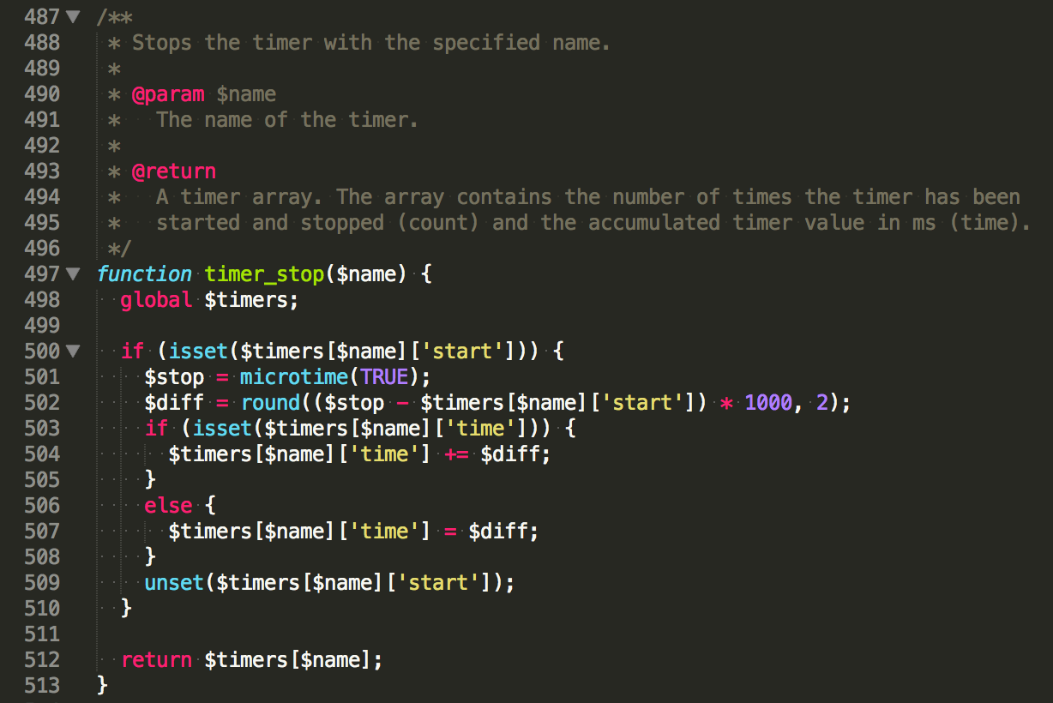
PHP Looks Like:
(PHP and other back-end developers do not write HTML, they write programs that write HTML)
Notes:
So what are we actually DOING?
We’re in the process of organizing an event for the end of Janaury.
We’ll give 9 high schools, 10 tickets each to give to interested high school girls. 10 tickets will be reserved for alternatively educated high school girls.
The event will be 2 days, held at Portland State University. There will be about 7 hands on workshops – and we’ll go more detail into those later.
Then, somewhat unique to ChickTech, we plan to have a structure mentoring approach. Instead of having this be a one-off event, we want to ensure that the participants (who showed interest during the workshops) remain engaged. To do this, we’ll meet with the girls every other month to build on what they learned. We’ll do that for 1 year.
And our plan is to have very little “talking at” and more “doing”.
Next we’ll go into details about workshops. At the end we’ll talk about how you can help.

Slide 17
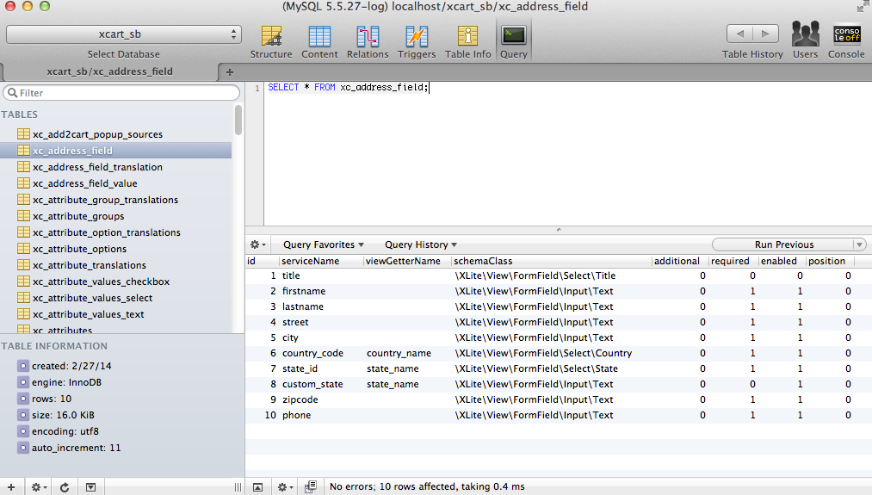
MySQL Database
Looks Like:
Data data data data data data data….. data.
Notes:
So what are we actually DOING?
We’re in the process of organizing an event for the end of Janaury.
We’ll give 9 high schools, 10 tickets each to give to interested high school girls. 10 tickets will be reserved for alternatively educated high school girls.
The event will be 2 days, held at Portland State University. There will be about 7 hands on workshops – and we’ll go more detail into those later.
Then, somewhat unique to ChickTech, we plan to have a structure mentoring approach. Instead of having this be a one-off event, we want to ensure that the participants (who showed interest during the workshops) remain engaged. To do this, we’ll meet with the girls every other month to build on what they learned. We’ll do that for 1 year.
And our plan is to have very little “talking at” and more “doing”.
Next we’ll go into details about workshops. At the end we’ll talk about how you can help.

Slide 18
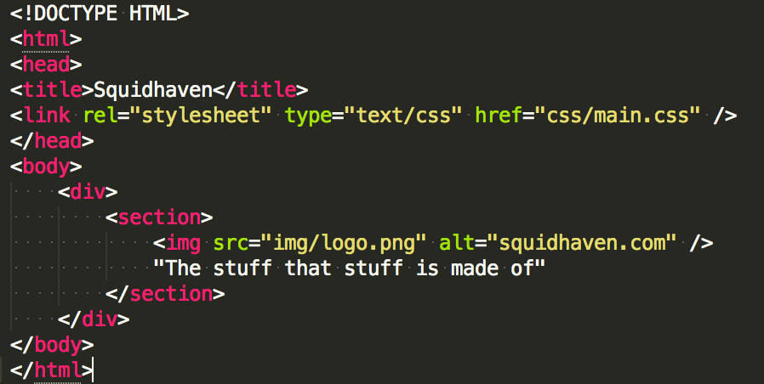
HTML Looks Like:
Boxes inside of boxes inside of boxes.
Notes:
So what are we actually DOING?
We’re in the process of organizing an event for the end of Janaury.
We’ll give 9 high schools, 10 tickets each to give to interested high school girls. 10 tickets will be reserved for alternatively educated high school girls.
The event will be 2 days, held at Portland State University. There will be about 7 hands on workshops – and we’ll go more detail into those later.
Then, somewhat unique to ChickTech, we plan to have a structure mentoring approach. Instead of having this be a one-off event, we want to ensure that the participants (who showed interest during the workshops) remain engaged. To do this, we’ll meet with the girls every other month to build on what they learned. We’ll do that for 1 year.
And our plan is to have very little “talking at” and more “doing”.
Next we’ll go into details about workshops. At the end we’ll talk about how you can help.

Slide 19
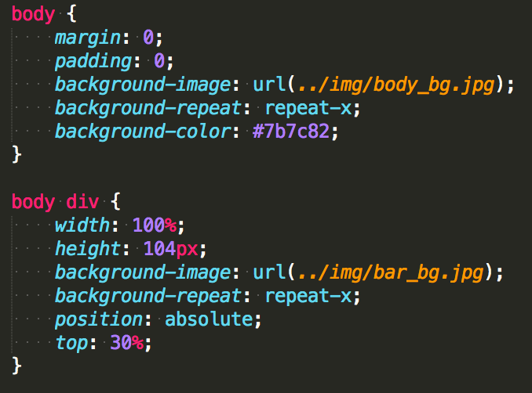
CSS Looks Like:
When people realized that boxes on their own just weren’t pretty enough.
Notes:
So what are we actually DOING?
We’re in the process of organizing an event for the end of Janaury.
We’ll give 9 high schools, 10 tickets each to give to interested high school girls. 10 tickets will be reserved for alternatively educated high school girls.
The event will be 2 days, held at Portland State University. There will be about 7 hands on workshops – and we’ll go more detail into those later.
Then, somewhat unique to ChickTech, we plan to have a structure mentoring approach. Instead of having this be a one-off event, we want to ensure that the participants (who showed interest during the workshops) remain engaged. To do this, we’ll meet with the girls every other month to build on what they learned. We’ll do that for 1 year.
And our plan is to have very little “talking at” and more “doing”.
Next we’ll go into details about workshops. At the end we’ll talk about how you can help.

Slide 20
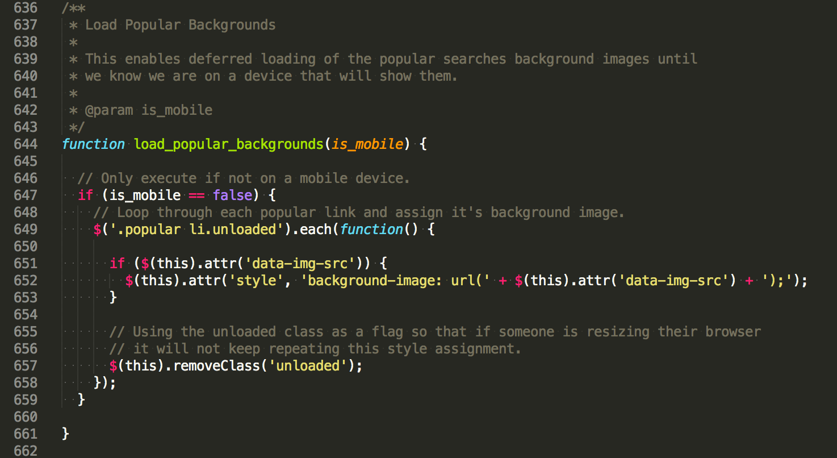
Javascript Looks Like:
For when people realized that even pretty boxes could still be way cooler.
Notes:
So what are we actually DOING?
We’re in the process of organizing an event for the end of Janaury.
We’ll give 9 high schools, 10 tickets each to give to interested high school girls. 10 tickets will be reserved for alternatively educated high school girls.
The event will be 2 days, held at Portland State University. There will be about 7 hands on workshops – and we’ll go more detail into those later.
Then, somewhat unique to ChickTech, we plan to have a structure mentoring approach. Instead of having this be a one-off event, we want to ensure that the participants (who showed interest during the workshops) remain engaged. To do this, we’ll meet with the girls every other month to build on what they learned. We’ll do that for 1 year.
And our plan is to have very little “talking at” and more “doing”.
Next we’ll go into details about workshops. At the end we’ll talk about how you can help.

Slide 21
Cheat Sheet
Linux : I’m the server’s operating system.
Apache : I’m web software that serves pages.
MySQL : I’m where all the data and content is stored.
PHP : I’m the code on the server that builds web pages.
HTML : I hold a web page together and provide the framework of the page.
CSS : I make a web page look pretty.
Javascript : I make a web page do stuff.
Notes:
So what are we actually DOING?
We’re in the process of organizing an event for the end of Janaury.
We’ll give 9 high schools, 10 tickets each to give to interested high school girls. 10 tickets will be reserved for alternatively educated high school girls.
The event will be 2 days, held at Portland State University. There will be about 7 hands on workshops – and we’ll go more detail into those later.
Then, somewhat unique to ChickTech, we plan to have a structure mentoring approach. Instead of having this be a one-off event, we want to ensure that the participants (who showed interest during the workshops) remain engaged. To do this, we’ll meet with the girls every other month to build on what they learned. We’ll do that for 1 year.
And our plan is to have very little “talking at” and more “doing”.
Next we’ll go into details about workshops. At the end we’ll talk about how you can help.

Slide 22
Open source
Generally, open source refers to a program in which the source code is available to the general public for use and/or modification from its original design. Open source code is typically created as a collaborative effort in which programmers improve upon the code and share the changes within the community. Open source sprouted in the technological community as a response to proprietary software owned by corporations.
Notes:
So what are we actually DOING?
We’re in the process of organizing an event for the end of Janaury.
We’ll give 9 high schools, 10 tickets each to give to interested high school girls. 10 tickets will be reserved for alternatively educated high school girls.
The event will be 2 days, held at Portland State University. There will be about 7 hands on workshops – and we’ll go more detail into those later.
Then, somewhat unique to ChickTech, we plan to have a structure mentoring approach. Instead of having this be a one-off event, we want to ensure that the participants (who showed interest during the workshops) remain engaged. To do this, we’ll meet with the girls every other month to build on what they learned. We’ll do that for 1 year.
And our plan is to have very little “talking at” and more “doing”.
Next we’ll go into details about workshops. At the end we’ll talk about how you can help.

Slide 23
Open source strengths
- Promotes creation of software that is not proprietary.
- Creation driven by interest, not money.
- Flexibility that you cannot get in closed software.
- Promotes extend and give back mentality.
Notes:
So what are we actually DOING?
We’re in the process of organizing an event for the end of Janaury.
We’ll give 9 high schools, 10 tickets each to give to interested high school girls. 10 tickets will be reserved for alternatively educated high school girls.
The event will be 2 days, held at Portland State University. There will be about 7 hands on workshops – and we’ll go more detail into those later.
Then, somewhat unique to ChickTech, we plan to have a structure mentoring approach. Instead of having this be a one-off event, we want to ensure that the participants (who showed interest during the workshops) remain engaged. To do this, we’ll meet with the girls every other month to build on what they learned. We’ll do that for 1 year.
And our plan is to have very little “talking at” and more “doing”.
Next we’ll go into details about workshops. At the end we’ll talk about how you can help.

Slide 24
Open source community
Who makes up the community:
- People from every corner of the globe come together out of a common interest to make something better.
- You.
Notes:
So what are we actually DOING?
We’re in the process of organizing an event for the end of Janaury.
We’ll give 9 high schools, 10 tickets each to give to interested high school girls. 10 tickets will be reserved for alternatively educated high school girls.
The event will be 2 days, held at Portland State University. There will be about 7 hands on workshops – and we’ll go more detail into those later.
Then, somewhat unique to ChickTech, we plan to have a structure mentoring approach. Instead of having this be a one-off event, we want to ensure that the participants (who showed interest during the workshops) remain engaged. To do this, we’ll meet with the girls every other month to build on what they learned. We’ll do that for 1 year.
And our plan is to have very little “talking at” and more “doing”.
Next we’ll go into details about workshops. At the end we’ll talk about how you can help.

Slide 25
Drupal & GetPantheon.com
Setup:
How to Instructions
Notes:
Ok, here’s the list of each of the workshops. We’ll go through each of these a bit. If something sparks your interest or raises suggestions, write it down and we’ll discuss ideas at the end. If something is unclear, feel free to ask and we can try to help answer them.
Later, I’ll give you the status of each of the workshops. For now, we’ll just talk about what the workshops are.

Slide 26
Brainstorm
Notes:
Ok, here’s the list of each of the workshops. We’ll go through each of these a bit. If something sparks your interest or raises suggestions, write it down and we’ll discuss ideas at the end. If something is unclear, feel free to ask and we can try to help answer them.
Later, I’ll give you the status of each of the workshops. For now, we’ll just talk about what the workshops are.

